Slide 1
Tank 2020 - Group 4
Team member:
Yunlei Lyu
Yangfan Wang
Jia Qi Zhao

Slide 2
Our Team
Jia Qi Zhao
Composing the modules and implementing full verifications.
Yunlei Lyu
Developing IPs for each components.
Yangfan Wang
Resolving potential timing issues.
Notes:
As we all have experience with FPGA and hardware design from ECE342 and internship, all of us will be contributing to the Verilog development

Slide 3
Do You Remember those 2D Classic Games from 90s?
Notes:
Do you guys still remember those classic 2d games that we used to play on Nintendo playstations, old Nokia cell phones.

Slide 4
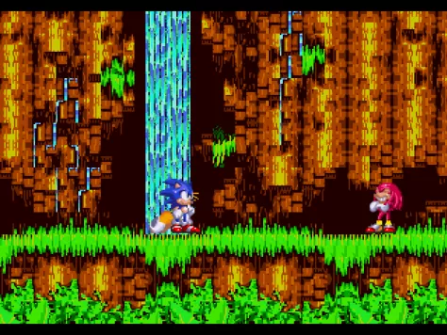
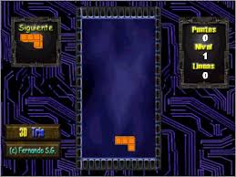

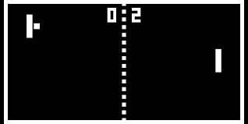
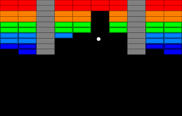

Slide 5

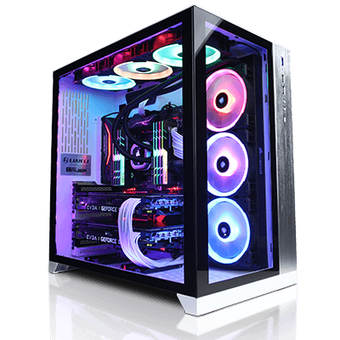
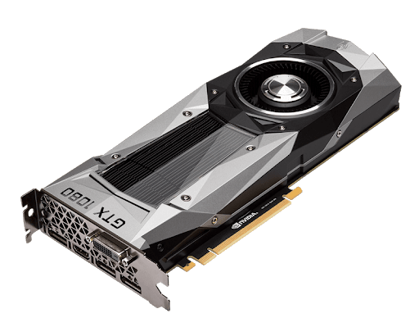


Notes:
However, as technology evolves these years, games become more and more complicated, in the meanwhile requiring huge amount of expensive hardware and software to run on. We noticed for most of time, we just want to go back and play those simple games quickly and have fun.

Slide 6
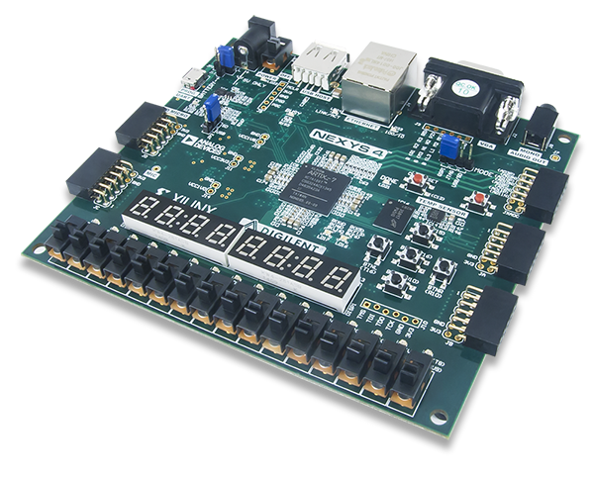
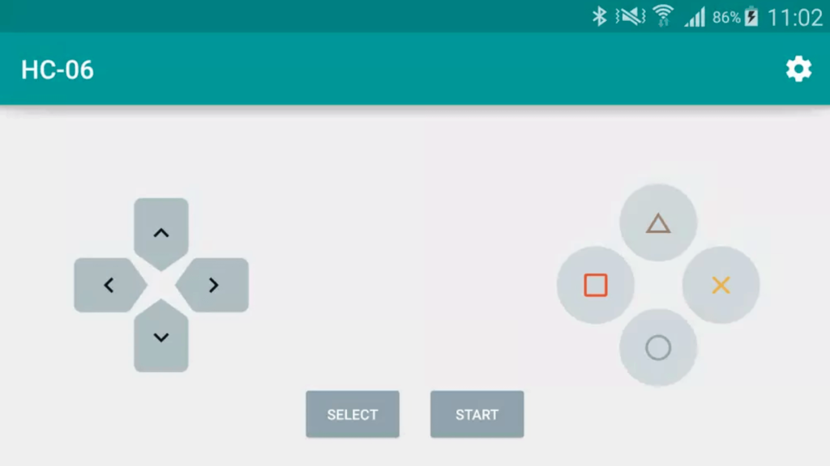
FPGA
Bluetooth Controller on Mobile Phone
Monitor

Slide 7
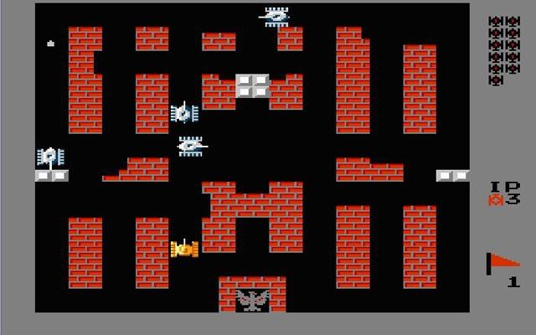
Tank 1990
Interactive
Simple to Play
Well-known

Slide 8
Tank 2020
Control Your Tank
Fire Shells to Attack Others or Destroy Walls
Avoid Opponents’ Shell
Protect Your Base

Slide 9
Possible AI Implementation
Notes:
As Tank 1990 is strategy game, balancing from attacking and defending. It is also a great opportunity to try if any Ai engine can be implemented on hardware directly.

Slide 10
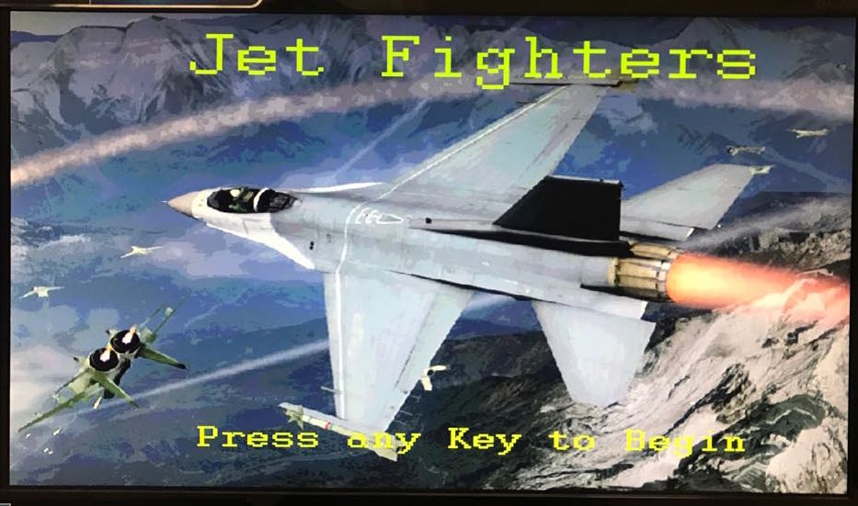
Similar Project
Jet Fighters from 2017

Slide 11
Tank 2020
Jet Fighters
HDMI
Computer AI
Various Maps
VGA
2-Player Battle
Plain Battlefield
vs

Slide 12
Tank 2020

Slide 13



Function Requirement
32x32 pixels
4x4 grid points
Bluetooth control
640*480 @ 30 fps
2 Types of wall
Move on a 80*60 grid.
20*15 chunks
Win condition
Lose condition

Slide 14
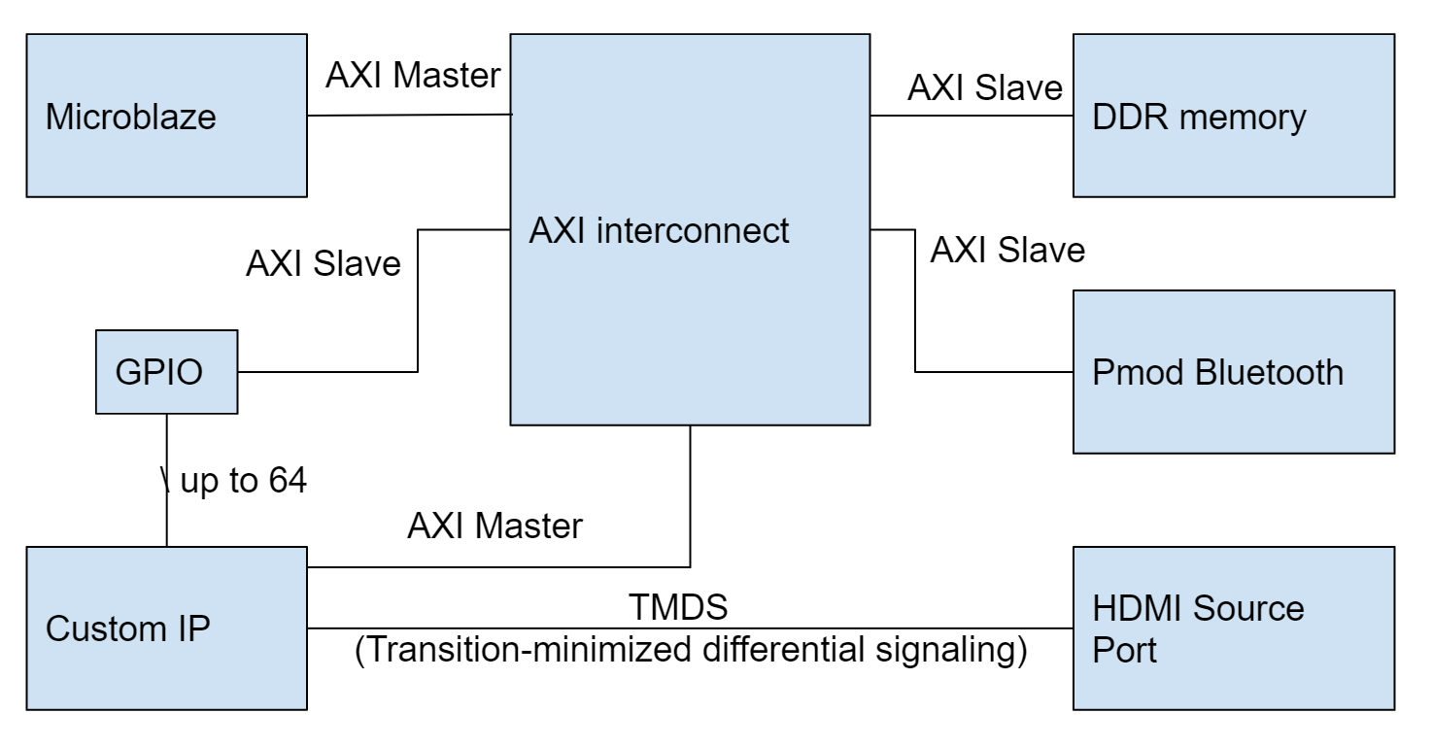
System overview
Internal modules use AXI connection
Drive HDMI sues TMDS standard

Slide 15
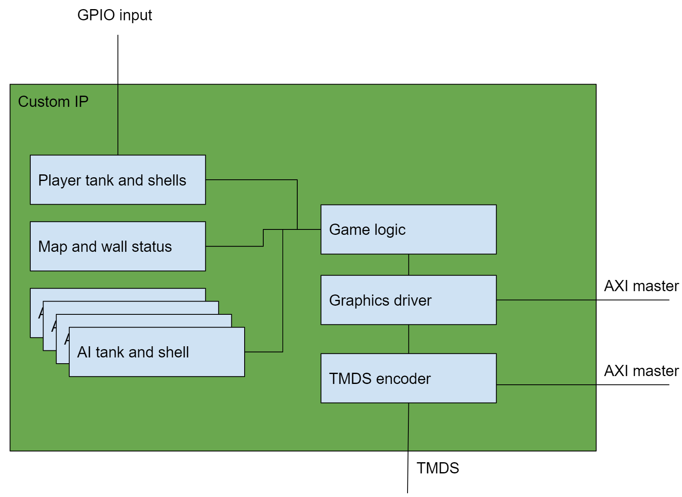
Custom IP Overview - Game Logic
Player tank and shells:
Calculate next player tank and shell position based on user input
AI tank and shell:
Calculate next AI tank and shell position
Map and wall status:
Register the status of each grid point.
Game logic:
Check win-loss condition

Slide 16
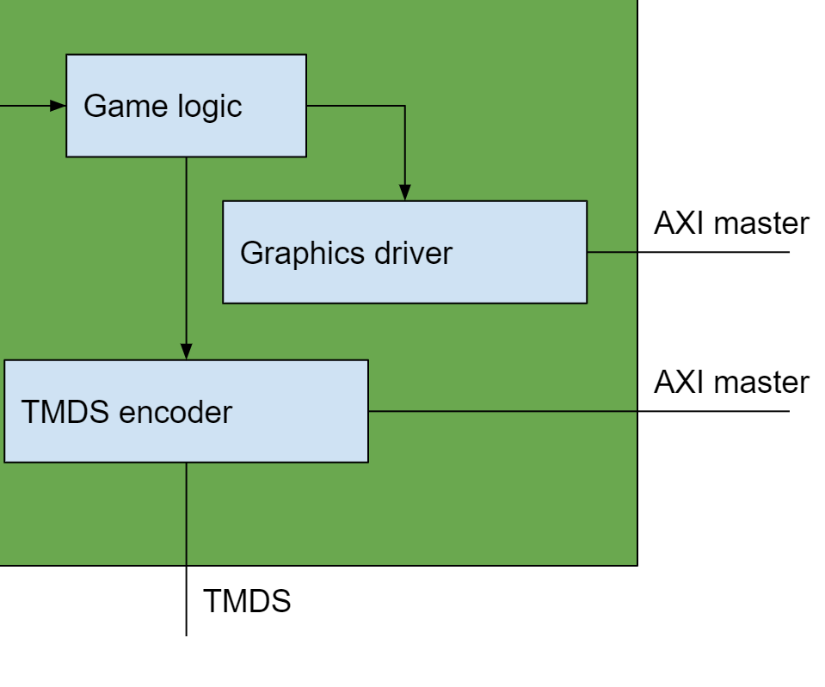
Custom IP Overview - Graphics
Graphics Driver:
Draw the frame to VRAM (DDR chip)
TMDS encoder:
Read VRAM and send signal to HDMI port.

Slide 17
Validation
Parts that can’t be validated via testbench:
Bluetooth, HDMI
Directly connects to board and use ILA for any bug encountered.
Parts that can be validated via testbench:
Game logic
3 Stages testing:
Functional test within each module.
Test package module using Verification IP.
System level tests.
Notes:
Thanks Yunlei, Now I would like to give you an overview of the validation plan. The validation plan consist of two major parts. First, the components cannot be validated through a test bench. Like Bluetooth or HDMI. The team would directly implement the design on board and use ILA to debug the design. For the parts that can be simulated via testbench, such as the game logic. The team would use a 3 stage validation approach. In the first stage, the team would test each individual components such as an algorithm for detecting if the tank has been hit directly using a testbench, at this stage the functionality requirements should be tested. Second after packaging the individual components as an AXI master or Slave. The team would use a Verification IP to send transaction to the package IP. Last, the team would write test sequence to simulate bluetooth input the verify the entire system.

Slide 18
Risk Mitigation
The main risks consist of components can’t be simulated via testbench.
HDMI
Bluetooth
Use VGA output by utilizing the VGA driver from previous courses.
Use keyboard as the primary input instead of a Bluetooth module.
Notes:
The main risks consist of HDMI or Bluetooth connection not working. Since these two main components can’t be simulated via testbench. To mitigate these risks, we have the following mitigation plan:
In case of HDMI output doesn’t work. The team would use VGA output by utilizing the VGA driver from previous courses.
In case of Bluetooth connection not working. The team would use the keyboard as the primary input instead of a Bluetooth module.
Therefore even if some parts of the system might not work as expected. The team is still confident enough to deliver the final product using one of those alternative methods.

Slide 19
Milestones
Milestone #1: Finish the basic layout of the entire system.
Milestone #2: Have Bluetooth working.
Milestone #3: Have the basics of HDMI working.
Milestone #4: Have HDMI working with the DDR memory.
Milestone #5: Finish game logic. The tank should be able to move around and fire via Bluetooth.
Milestone #6: The AI should be working, integrating the system.
Milestone #7: Final demo.
Notes:
Our risk and risk mitigation plan, give rise to the following milestones, at the first stage the team would finish the basic layout of the system, then work on the components that can’t be verified easily such as the bluetooth and HDMI. Last the team would work on the game logic and integrated the entire system.

Slide 20
Conclusion and Q&A
Notes:
With those risk mitigation plan and workflow. The team is confident enough to finish this project on time. Thanks you.

